Slide 1



COLORADO DEPARTMENT OF CORRECTIONS NORMALIZATION INITIATIVE

Slide 2
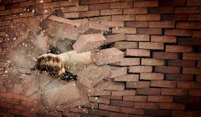
TODAY
Introduce normalization and potential areas of change
Plan moving forward
Your thoughts
“We build too many walls and not enough bridges.”
-Sir Isaac Newton
Notes:
Today we are going to begin with a brief presentation on normalization and some of the proposed changes. This will make sure was are all on the same page and have the same background as we begin our discussion
We will be giving you handouts so you will be able to reference them as we all work together in this initiative and for you to share with others
We want to hear your thoughts! We want to know what you think of the initiative, what changes would potentially work for your area and your facility, the impact of the changes, and any hesitations you may have. etc

Slide 3

WILDLY IMPORTANT GOALS (WIGs)
Decrease the recidivism rate through normalization of prison
Increase the percentage of parolees who are employed
Improve culture within DOC and decrease labor shortage
Notes:
WIG #1: with this WIG comes the following
-By September 1, 2019, establish policy for prison normalization principles and ensure initial implementation of the principles in the facilities by September 30, 2019
-Ensure full operational implementation of twenty principles of prison normalization in facilities by March 30, 2020
Important to note that the 2 other WIGS also relate directly to normalization., They are…
CLICK
2. Increase the percentage of parolees who are employed
3. Improve culture within DOC and decrease labor shortage

Slide 4
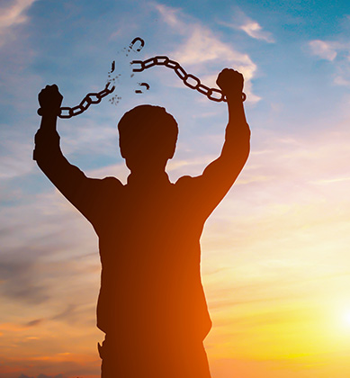
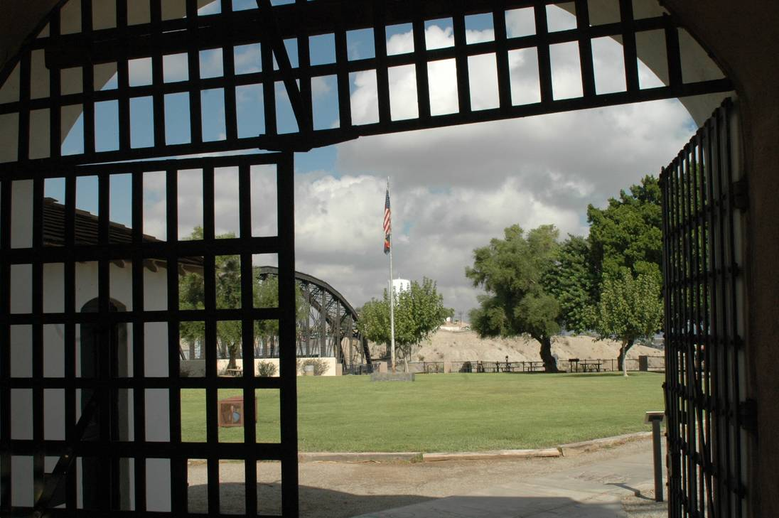
WHAT IS NORMALIZATION?
Normalization aims to bring prison life as close as possible to normal life outside of prison.
Notes:
Normalization is achieved through various concepts and changes, each of which are supported by scientific research. Today, we will be discussing some of the research that supports a few of the suggested changes to correctional environments.

Slide 5
CHANGES WE CONSIDER/ IMPLEMENT
Should NOT increase inherent risks
Do NOT modify processes in ways that increase risk for staff or offenders
Should NOT inundate staff
Do NOT increase staff workload
Should NOT perpetuate and us versus them culture
Objective is to break this paradigm
Notes:
As we move forward with the normalization initiative, considering potential changes and beginning to implement changes it is important to note that any of the proposed or implemented changes should…
Not increase inherent risks – that is, we do not want to have any changes (physical or procedural) that will increase risk/danger for staff or offenders
Not increase staff workload – these changes should improve the overall work environment and staff-offender interactions, they should not create more work for staff
Not perpetuate an us versus them culture – the objective is to break the paradigm of us versus them, not create any new divisions

Slide 6


POTENTIAL AREAS OF CHANGE
Physical Environment
Staff Offender Interactions
Dynamic Security

Slide 7
CHANGE THE PHYSICAL ENVIRONMENT
Paint walls
Add color to communal spaces
Paint Murals
Add gardens
Add trees
Plant flowers
Plant fruits and vegetables
Integrate music
Change fluorescent lights
Add more green space
Create addition natural lighting
Additional cooking options
Unbolt furniture
Add décor
Change plumbing fixtures
Change lighting fixtures
Notes:
The initial area of focus for our normalization initiative is to change the physical environment
We are considering implementing a variety of changes that have been used to normalize other correctional environments such as…
Painting walls and adding color to communal spaces
Planting gardens, trees, and flowers
Changing fluorescent lights and increasing natural light
Unbolting furniture and changing fixtures
Integrating music and cooking spaces

Slide 8

MUSIC
Listening to classical or instrumental music increases relaxation and reduces anxiety, tension, stress, anger and aggression.
Music with fast rhythms or tempos can have similar beneficial effects when the individual selects the music.
Bensimon, Einat, & Gilboa, 2015; Jiang, Rickson, & Jiang, 2016; Jiang, Zhou, Rickson, & Jiang, 2013; Krahé & Bieneck, 2012; Labbé; Schmidt, Babin, & Pharr, 2007; Nilsson, 2008; Schäfer, Huron, Shanahan, & Sedlmeier, 2015; Smith & Joyce, 2004
Notes:
Research has linked listening to classical or instrumental music to increases in relaxation and reductions in
Anxiety
Tension
Stress
Anger
And aggression
CLICK:
Interestingly, music with fast rhythms or tempos can have similar beneficial effects when the individual is able to select their own music
Before implementing music in a correctional environment, it is important to test if the music fits the cultural background of the offenders and their general music preferences.
Forcing individuals to listen to music over loud speakers that does not match their preferences may reduce the beneficial effects music has to offer.
STOP
Just in case there is a question: unpreferred music with fast rhythms or tempos does not reduce stress and tension

Slide 9

BENEFITS OF LIGHTING
Dawn simulation lighting at wake-up time increased alertness during the day, positive mood, well-being and cognitive performance.
Artificial light exposure to blue light vs white fluorescent light increases positive mood, well-being, alertness, productivity and quicker relaxation following a stressor.
Natural light (During the Day) regulates circadian rhythms, improves sleep quality, reduces depressive symptoms, improves mood, increases productivity throughout the day.
Notes:
The amount of and type of light present can greatly impact individuals
CLICK
Dawn simulation lighting, that is lighting that gradually increases in intensity beginning 30 minutes prior to wake-up time increases alertness during the day, positive mood, well-being and cognitive performance.
CLICK
Artificial light exposure to blue light vs white fluorescent light increases positive mood, well-being, alertness, productivity and leads to quicker relaxation following a stressor.
CLICK
Natural light during the day regulates circadian rhythms which are individuals 24 hour sleep-wake cycles, improves sleep quality, reduces depressive symptoms, improves mood, increases productivity throughout the day.
STOP
In case there is a question:
Light at Night
Disrupts circadian rhythms
More difficult to fall asleep
Negative Moods
Higher likelihood of exhibiting depressive symptoms

Slide 10
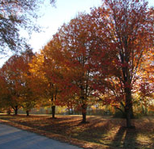

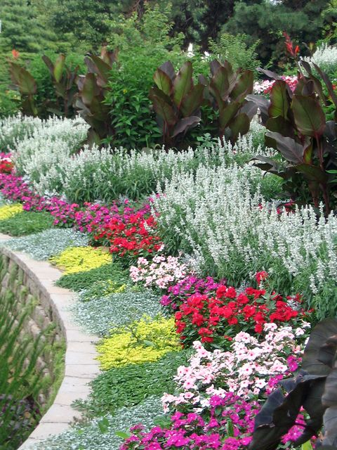

WHAT IS GREEN SPACE?
Grass
Gardens Structures
Trees
Flowers
Plants
Landscaping
Notes:
Green space is….

Slide 11
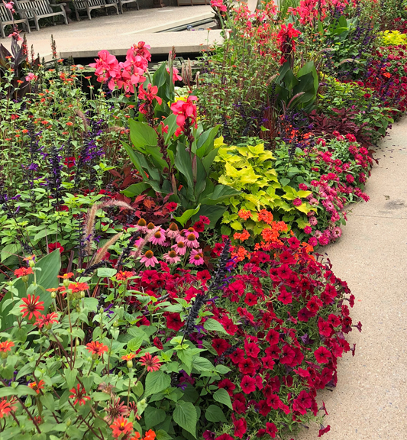
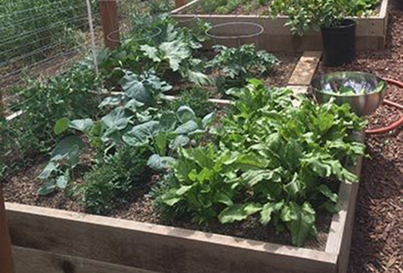
WHAT ARE THE BENEFITS OF GREENSPACE?
Increases feelings of calm and peacefulness
Increases physical health
Decreases feelings of pain, reduced heart rate, blood pressure, and cortisol levels
Reduces negative emotions
Reduces stress, anxiety, depression, fear, anger, sadness, and irritability
Provides a sense of normalcy and cultivates connection to the world outside of prison
Associated with fewer infractions
Brooks, Ottley, Arbuthnott, & Sevigny, 2017; Moran, 2019; Nadkarni, Hasbach, Thys, Crockett, & Schnacker, 2017; Reddon & Durante, 2019; Söderlund & Newman, 2017; Thompson, 2018
Notes:
Greenspace positively impacts individuals in a variety of ways
CLICK
Increases feelings of calm and peacefulness
CLICK
It increases physical health – specifically it decreases feelings of pain, reduced heart rate, blood pressure, and cortisol levels
CLICK
It reduces negative emotions such as stress, anxiety, depression, fear, anger, sadness, and irritability
CLICK
It provides a sense of normalcy and cultivates connection to the outside world
CLICK
And is associated with fewer infractions
These benefits are gained through
Walking through the space
Gardening
Presence of indoor plants
Viewing it through virtual reality or images
STOP
When deciding how best to implement greenspace in a prison environment it is important to consider how
-it impacts offenders’ ability to hide contraband and escape
-and that viewing from afar with no access can be unsatisfying

Slide 12

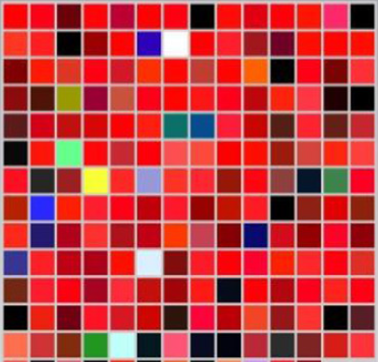

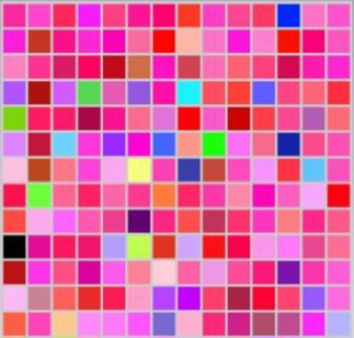
ART/ COLOR
Viewing art and images impact individuals’ moods
Emotions are associated with colors
Color impacts feelings
Notes:
The artwork on the walls or the colors of a room can impact individuals.
CLICK
Viewing arts and images affects individuals’ moods. For example, viewing images of dessert positively impact individuals’ moods, while viewing colored nature scenes decrease tension and negative mood.
CLICK
Emotions are associated with distinct colors
CLICK
Colors impact individuals’ feeling
For example
Red elicits increases in feelings of arousal, stimulation, warmth, and excitement (vs Blue and Gray)
Blue elicits feelings of spaciousness, restfulness, calm, and peacefulness (vs Red)
STOP Gray elicits feelings of calm and peacefulness (vs Blue)
STOP
Color images are from a study where people picked the color that represented each emotion (Gilebrt, Fridlund, & Lucchina, 2016). Relaxed, Anger, Romantic, and Sad are the emotions depicted.
Viewing abstract art is associated with feelings of fear and sadness
Realistic images evoke more emotion than artistic images

Slide 13

STAFF/OFFENDER INTERACTIONS
Positive interactions ease transitions to prison/new housing units
Recognition of effort and change leads to more positive self-images and greater commitment to the change
Social distance hinders offender re-entry success
Firm, fair, and caring approach reduces likelihood of recidivism
Effective communication reduces incidents and increases safety
Notes:
The interactions between staff and offenders has been shown to have an impact on offender functioning.
CLICK
Positive, supportive interactions with staff help ease offenders’ transitions to prison and new housing units
CLICK
When staff recognize positive changes in offenders it validates their hard work and feels rewarding, This encourages offenders to keep with the positive changes and leads to more positive and fulfilling self-images
CLICK
Social distance is the level of trust and perceived similarity between 2 individuals. If there is large social distance, re-entry into community can be hindered because offenders do NOT feel they are understood, have support, and someone they can trust. A firm, fair, and caring approach reduces the likelihood of recidivism.
CLICK
Communication is the first line of defense and effective communication can prevent incidents and increase overall facility safety. When engaging with offenders, keeping one’s promises and commitments, answering their questions or directing them to someone who can if you cannot all increase your credibility with offenders. Communication can also be used to defuse situations. Through communication staff gain more understanding of the offenders and the knowledge about their interactions and happening, which can be used to prevent incidents and increase safety.

Slide 14
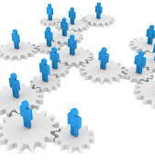

WHAT IS DYNAMIC SECURITY?
Continuous monitoring of prison security through staff/offender interactions
Training
Rapport building
Networking
Intelligence gathering
Strategic analyses
Developing skills of offenders
Notes:
Dynamic security is the continuous monitoring of prison security through staff/offender interactions in order to create a safer environments; it is based on firmness and fairness. Staff are trained and encouraged to develop personal relationships with offenders, getting to know and understand them as individuals, be sympathetic to personal, and engage in meaningful conversations with them – all of this while still maintaining a level of distance and professionalism. This leads to staff building rapport and networking with offenders. These relationships allow staff to gather intelligence through offenders sharing information and through staff observation – as staff get to know the offenders they are able to notice subtle changes (e.g., behavioral) and interrupt events at that stage before they escalate. Offenders are kept busy and encouraged to participate in constructive and purposeful activities that contribute to their reintegration into the community
Dynamic security is an additional level security – it does not replace physical security (walls, bars, locks, alarm systems) or procedural security (rules relating to movement, possessions, searches), rather it is used with these other levels of security to further increase security and safety by knowing what is going on in a prison.

Slide 15
BENEFITS OF DYNAMIC SECURITY
Less disruption and disorder
More acceptance of prison staff authority
Ability to assess offenders’ adjustment and stability
Increased information gathering
Safer environment for both staff and offenders
Notes:
The daily interactions between staff and offenders greatly influences offenders’ behaviors and attitudes. Dynamic security has been associated with a variety of positive outcomes.
CLICK
When offenders are treated with humanity, dignity, and fairly they are less likely to cause disruption and disorder
CLICK
And are more likely to respect and accept staff authority
CLICK
When staff know the offenders on a more personal level, they are able to recognize how the offenders are adjusting to their environment and if they are emotionally and behaviorally stable. If changes are noticed, staff are able to have a conversation with the offenders to determine what is going on and refer them to any needed services
CLICK
There is an overall increase in awareness of what is occurring in the unit/facility. Because staff are viewed as approachable and offenders have confidence in staff, good quality information is received from and about offenders, which can be used to prevent escapes and control problems/criminal activity
CLICK
Overall, dynamic security is associated with safer environments for both staff and offenders. Through staff’s positive interactions and rapport building with offenders, they are able to anticipate and prevent problems before they arise.
STOP
There is increased risk of manipulation of staff so it is important to train staff on how to engage in these interpersonal interactions while maintaining boundaries, staff can be rotated so they are not with the same set of offenders for too long, routine and random searches of staff entering prison, etc.

Slide 16

AS WE MOVE FORWARD
Communication
Training Development
Surveys
Focus Groups
Notes:
Communication – we will be as transparent as possible in this process and will work with each facility to create changes that best serve them and we will keep everyone informed of the outcomes of these changes. Throughout the entire process we would like feedback from you (feedback loop). That communication process begins today…
Training development – as we move forward with the initiative we will provide everyone with the necessary training and other resources needed to successfully implement the various changes
Surveys and focus groups asking your thoughts, opinions, and experiences on things related to the normalization initiative. The UCCS research team will be collecting and analyzing the data to determine how the normalization initiative has impacted the CDOC

Slide 17

QUESTIONS & CONTACT INFO
The Normalization Initiative is in the early stage of development and is being directed by Matt Hansen, Prison Operations. A work group of representatives across CDOC have been assembled. We will be soliciting more information from you in the coming weeks.
doc_normgroup@state.co.us
What questions or comments do you have on the Initiative?

